Slide 1
Disposal of Contaminated Water -Concerns of Korea-
PARK Jiyoung
THE ASAN INSTITUTE FOR POLICY STUDIES

Slide 2
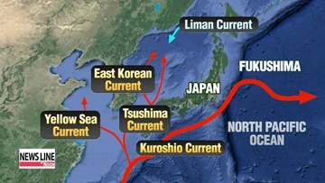
Scientific Basis for the Concern
Radioactivity (2013 UNSCEAR report)
100-500 PBq of Iodine, 6-20 PBq Cesium
10-20 PBq of Iodine, 3-6 PBq Cesium directly into the ocean
Release of radioactive water
Ocean current of the North Pacific Ocean
Release period, concentration, frequency determines the impact of the release
Impact on ecosystem
Seabed sediments
Marine products

Slide 3
Concerns over Nuclear Energy in ROK
General concern
Concerns on nuclear safety & radiation
Nuclear Phase-out Policy
Government
Early closure or no license renewal for the NPPs
Focusing on renewables
Civil Society
Environmental concern
Radiation phobia : Fukushima accident, Radon-emitting products
Political elements?

Slide 4
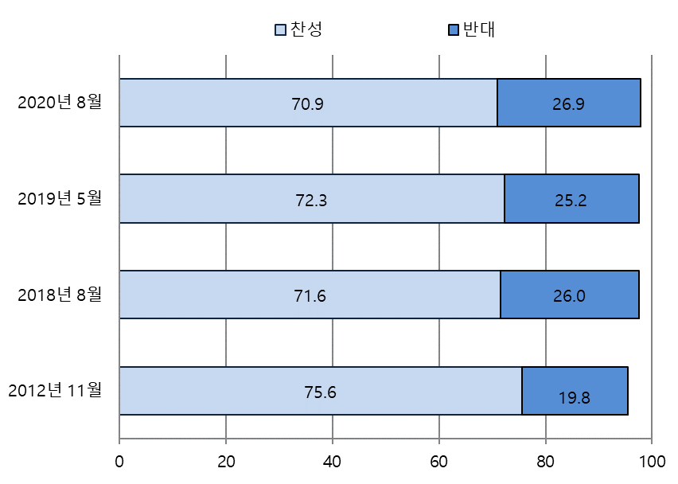
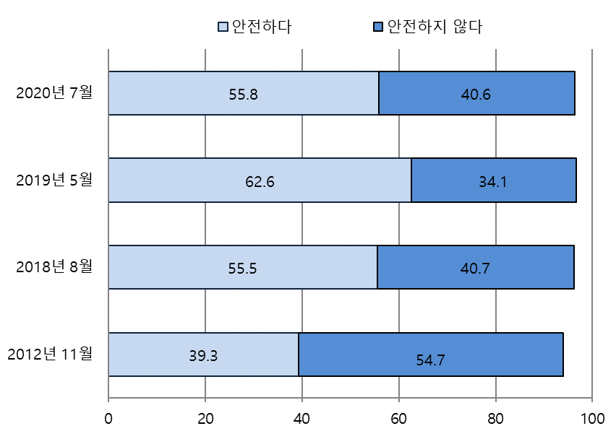
Concerns over Nuclear Energy
Nuclear Energy
Positive
Negative
Nuclear Safety
Safe
Not Safe

Slide 5
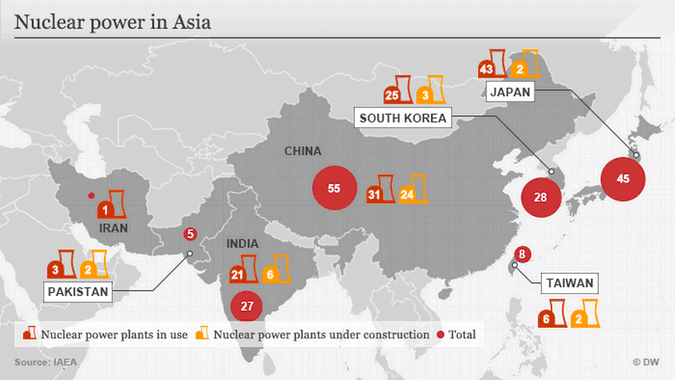
Nuclear Plant in Asia

Slide 6
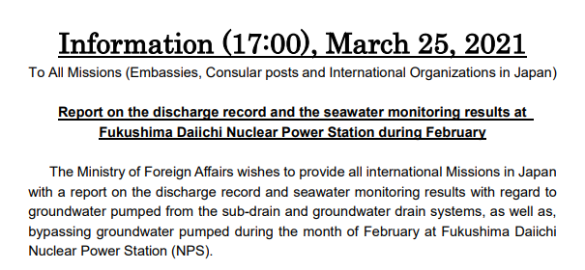
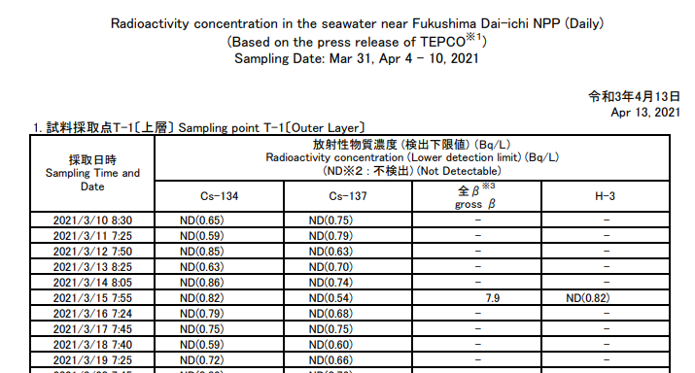
Information & Dissemination
Regular information updates on Fukushima

Slide 7
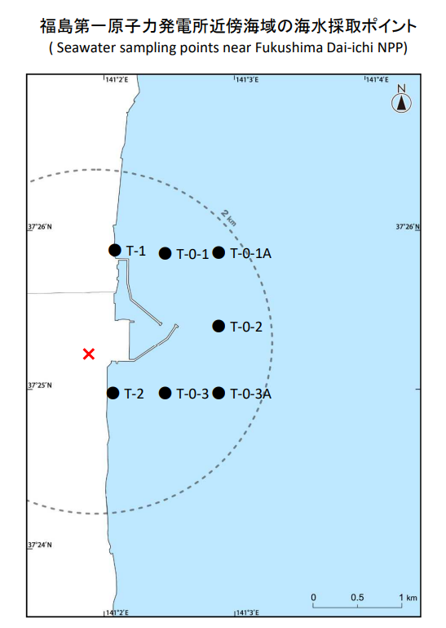
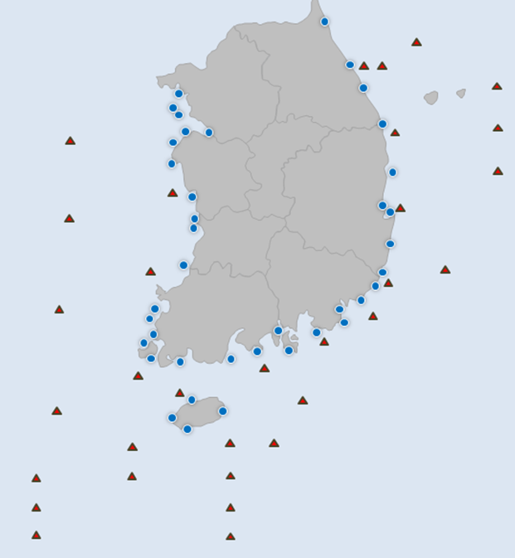
Monitoring
Fukushima, Japan
ROK

Slide 8
Monitoring & Responses
Regular information updates
Monthly update toward Embassies & Int’l organizations in Japan
Neighboring countries
No notable discussion or cooperation with ROK, China, Russia
No notable discussion or cooperation between ROK, China, Russia
Discussion and cooperation between US & Japan?

Slide 9
Public Concern

Slide 10
Public Concern
Rumors fuel social media user’s conspiracy theories on Fukushima radiation

Slide 11
Recommendation
Domestic credibility
Japan’s anti nuclear movement is critical
Consent from Japan’s fishing industry
International assistant needed
Scientific evidence should dominate
Appropriate response toward fake news and rumors
Transparent and consistent information sharing on Fukushima
Trust-building in the region
Cooperation to solve the issue
Communication first : 1.5 trek meeting

Slide 12
Thank you
PARK Jiyoung
jpark@asaninst.org

